Slide 1
Donut - economy
Les 5

Slide 2
Kijkopdracht:
https://www.ted.com/talks/kate_raworth_a_healthy_economy_should_be_designed_to_thrive_not_grow#t-527679

Slide 3
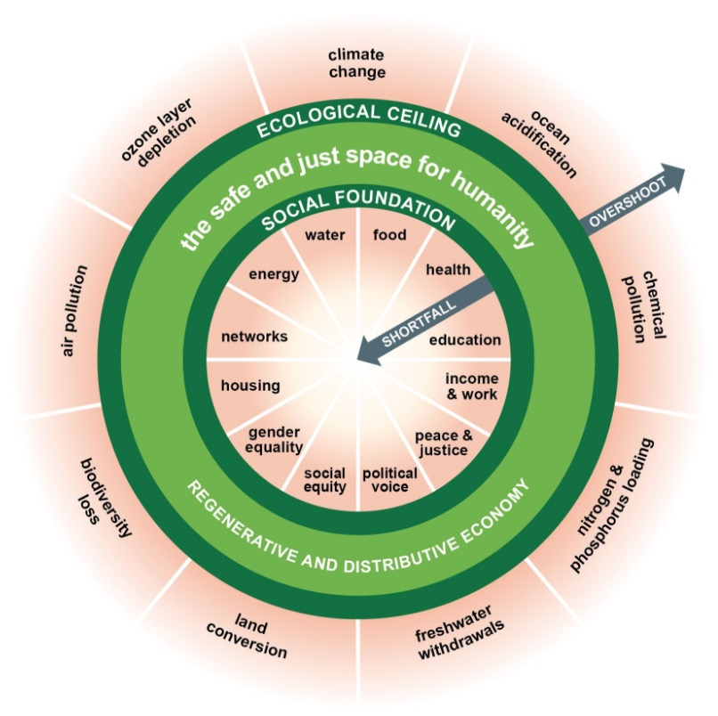

Slide 4
